Slide 1
Group 6 Dillama
Presentation 2
Notes:
Everyone

Slide 2
The Brief
2D
Tap input
Turn-based single-device multiplayer
Symmetric level design
Easy to learn game yet hard to master
Notes:
Tom
Input is single instant of contact.
Local multiplayer – adversarial. Asynchronous player turns.
Symmetric – players have access to the same knowledge and equal opportunity regarding input effect.

Slide 3
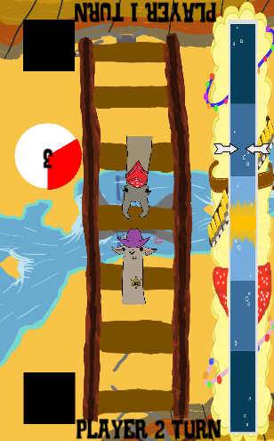
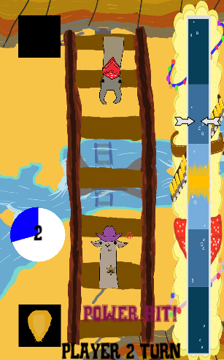
What is our Game?
Timed tap
Asynchronous, turn based
Symmetrical, first turn
Time, tap, progress
Win/loose condition
Notes:
Tom

Slide 4
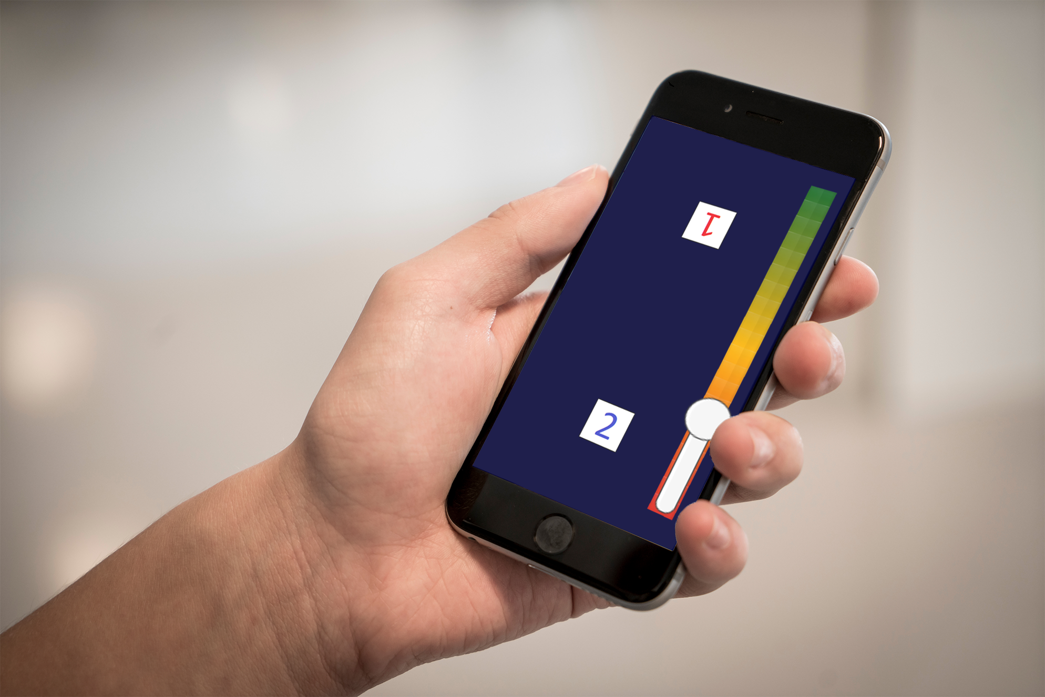
What does the player do?
Notes:
Tom

Slide 5
Final Build
Most accurate tap wins first turn
Timed tap yields greater effect
Notes:
Tom

Slide 6
Final Build
Win condition
Notes:
Tom

Slide 7
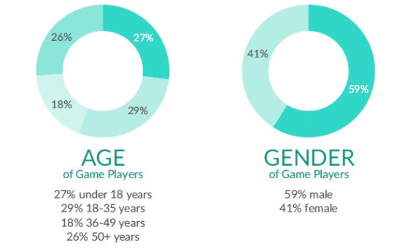
Target Audience
Casual mobile gamers
14 – 35 year old males
Game emotion relates to demographic
Source: https://ukie.org.uk/sites/default/files/UK%20Games%20Industry%20Fact%20Sheet%20February%202018.pdf (pp. 15)
Notes:
Tom

Slide 8
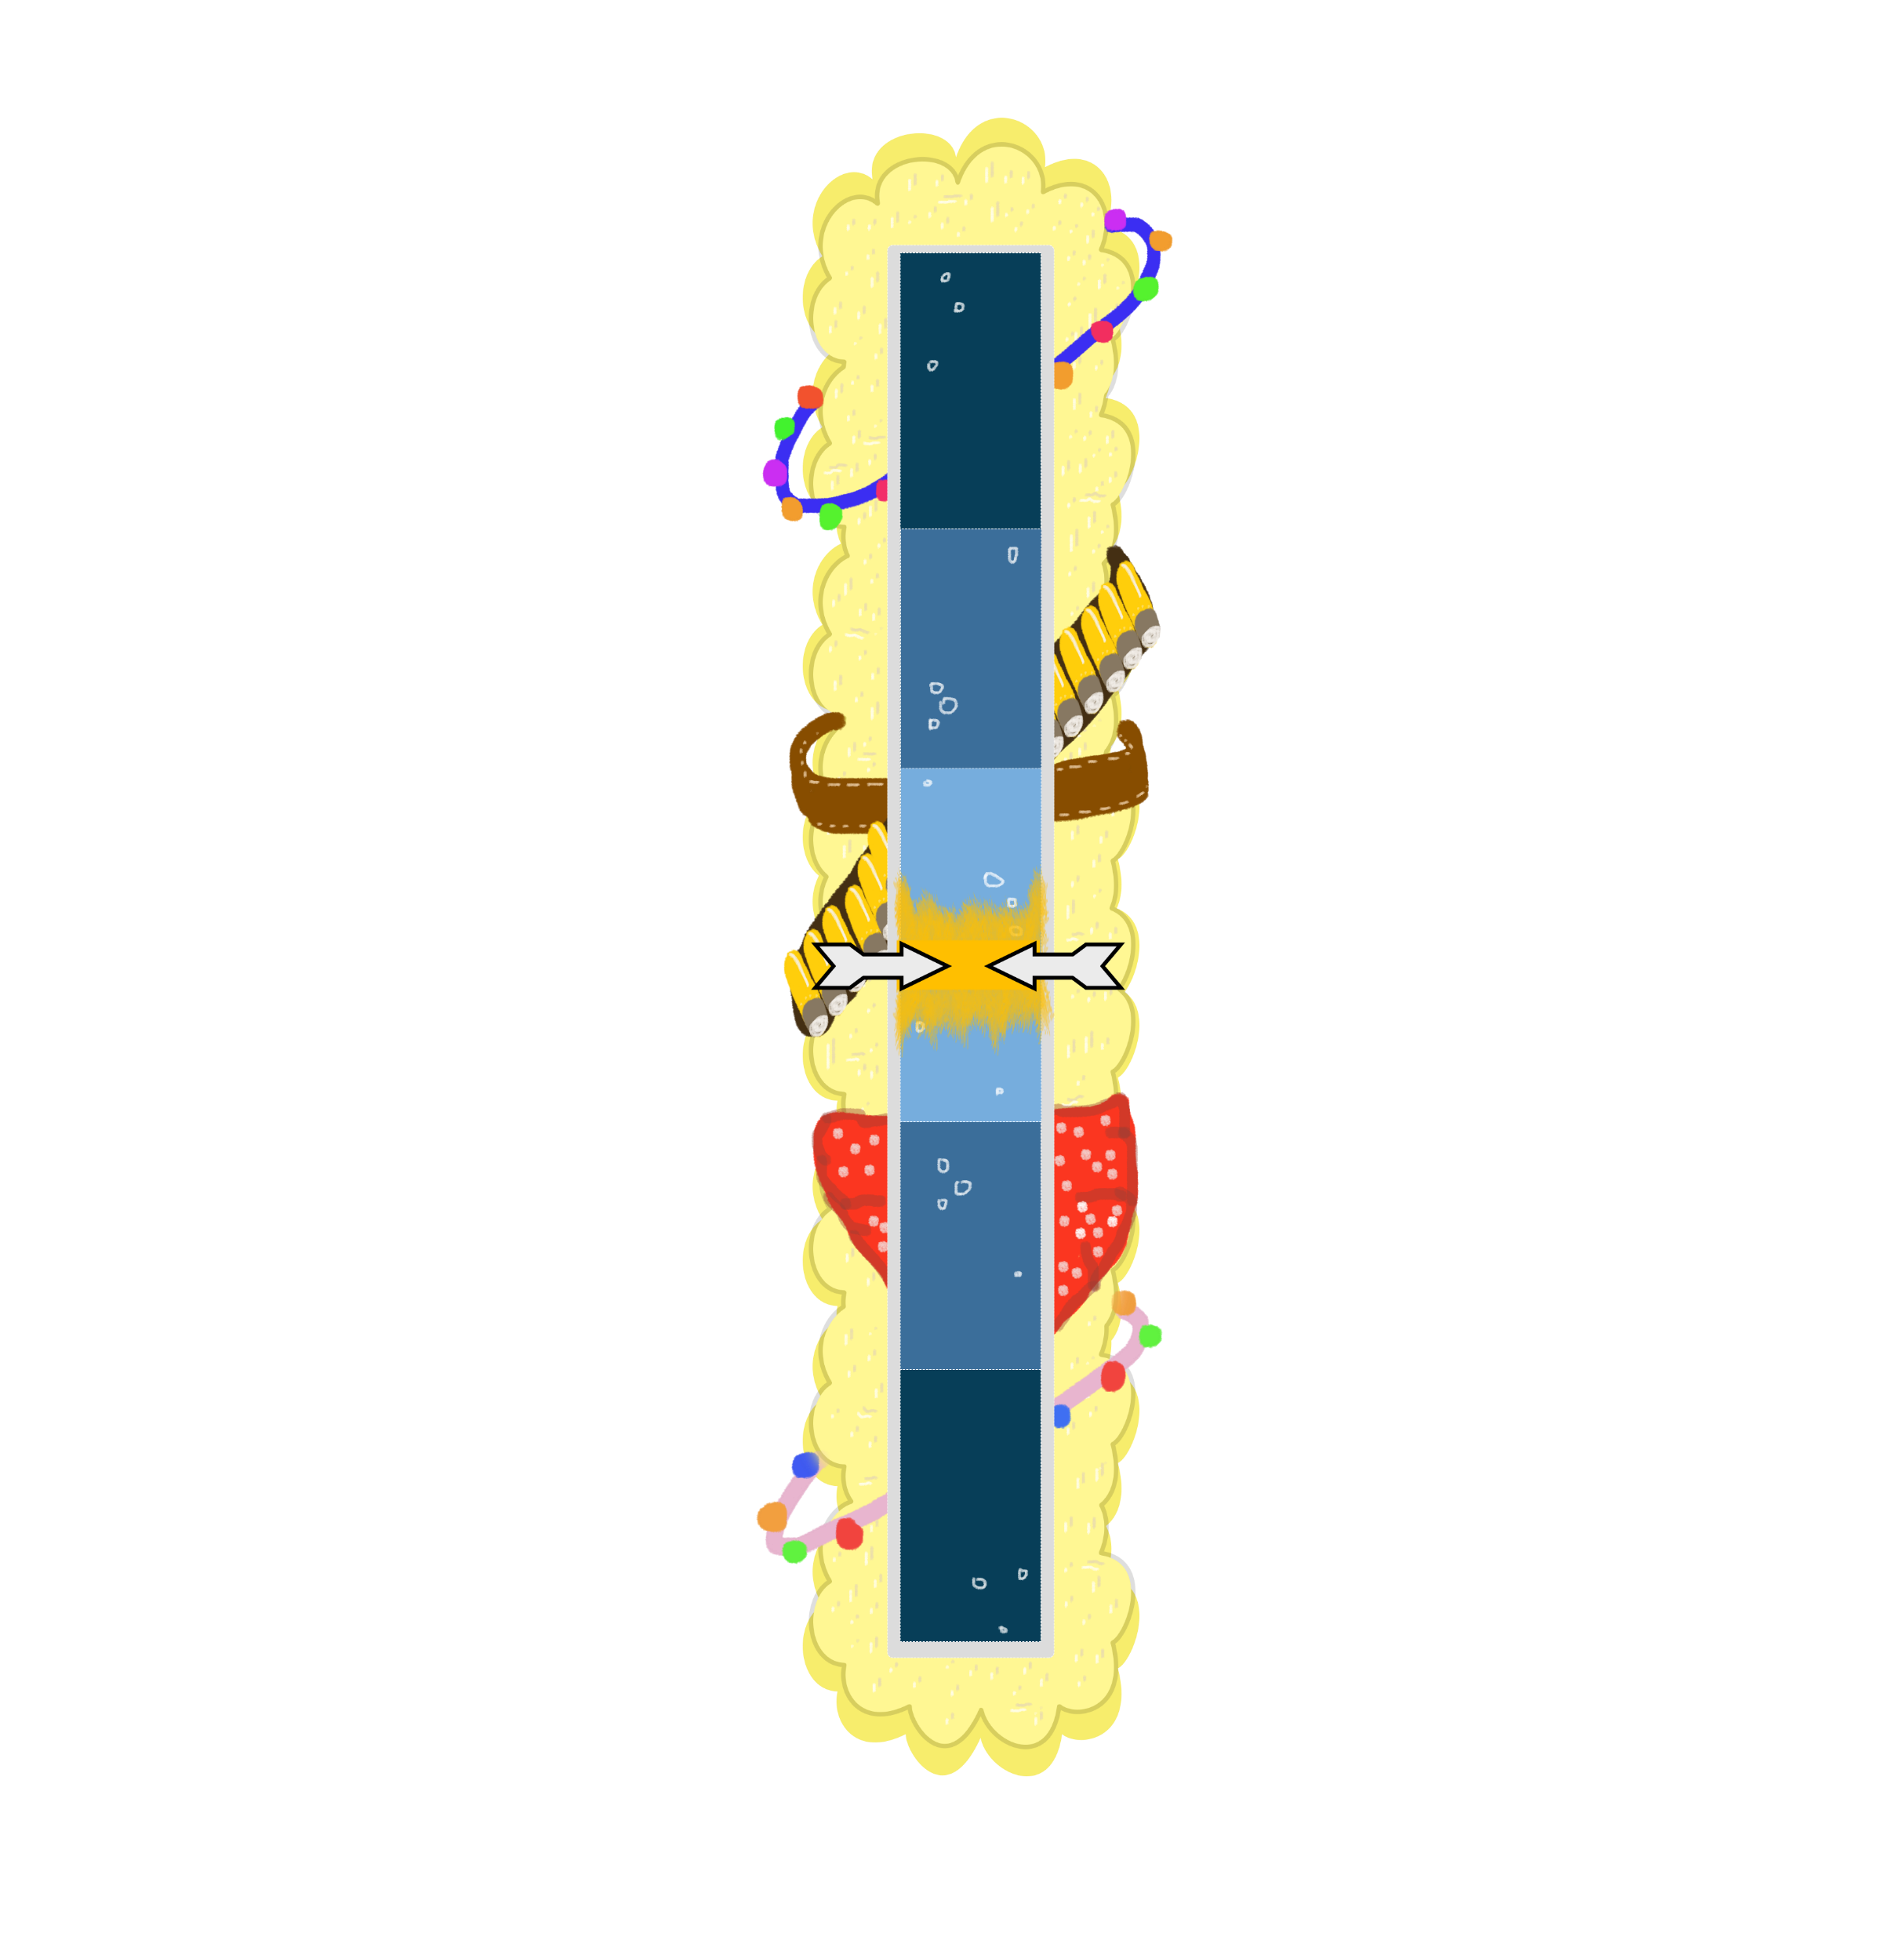

Art – Power Meter
Notes:
Dan

Slide 9

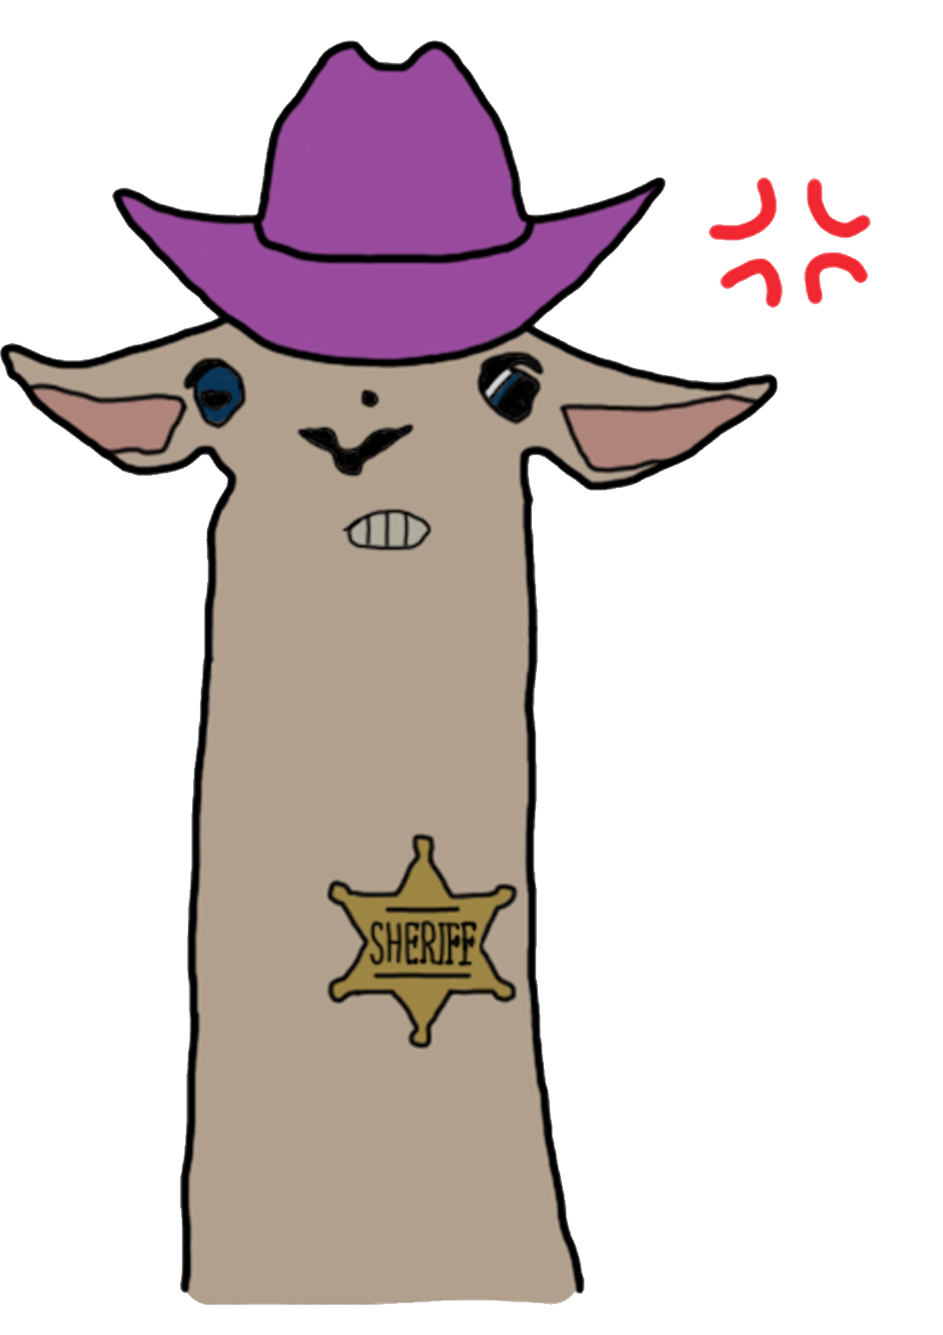


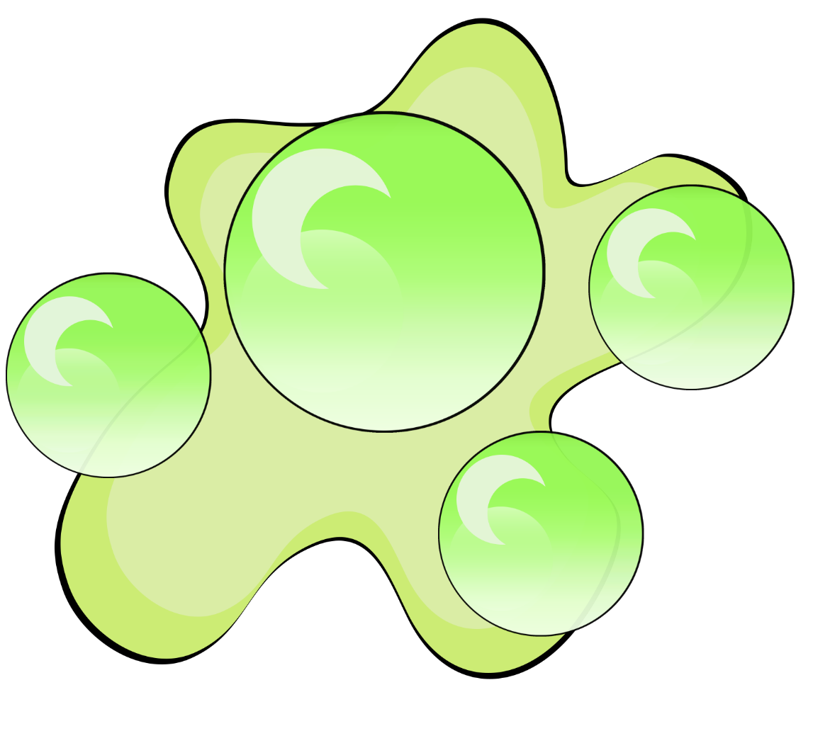

Art – Character Design
Notes:
Jack

Slide 10
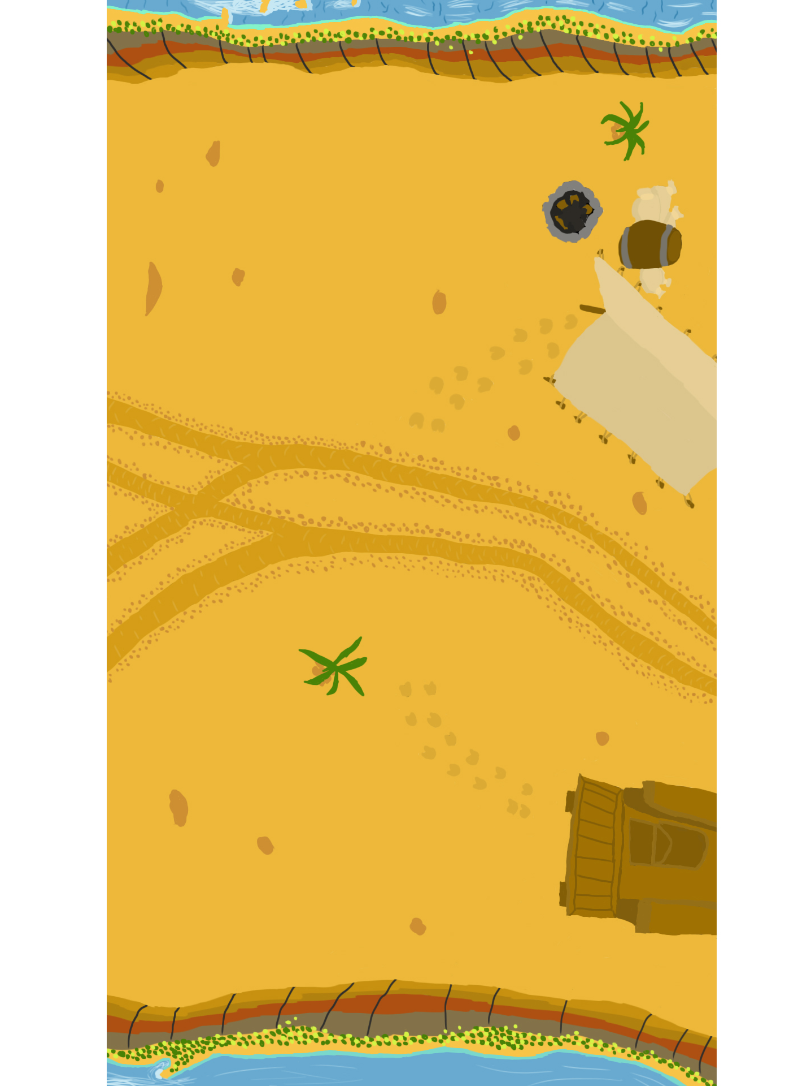
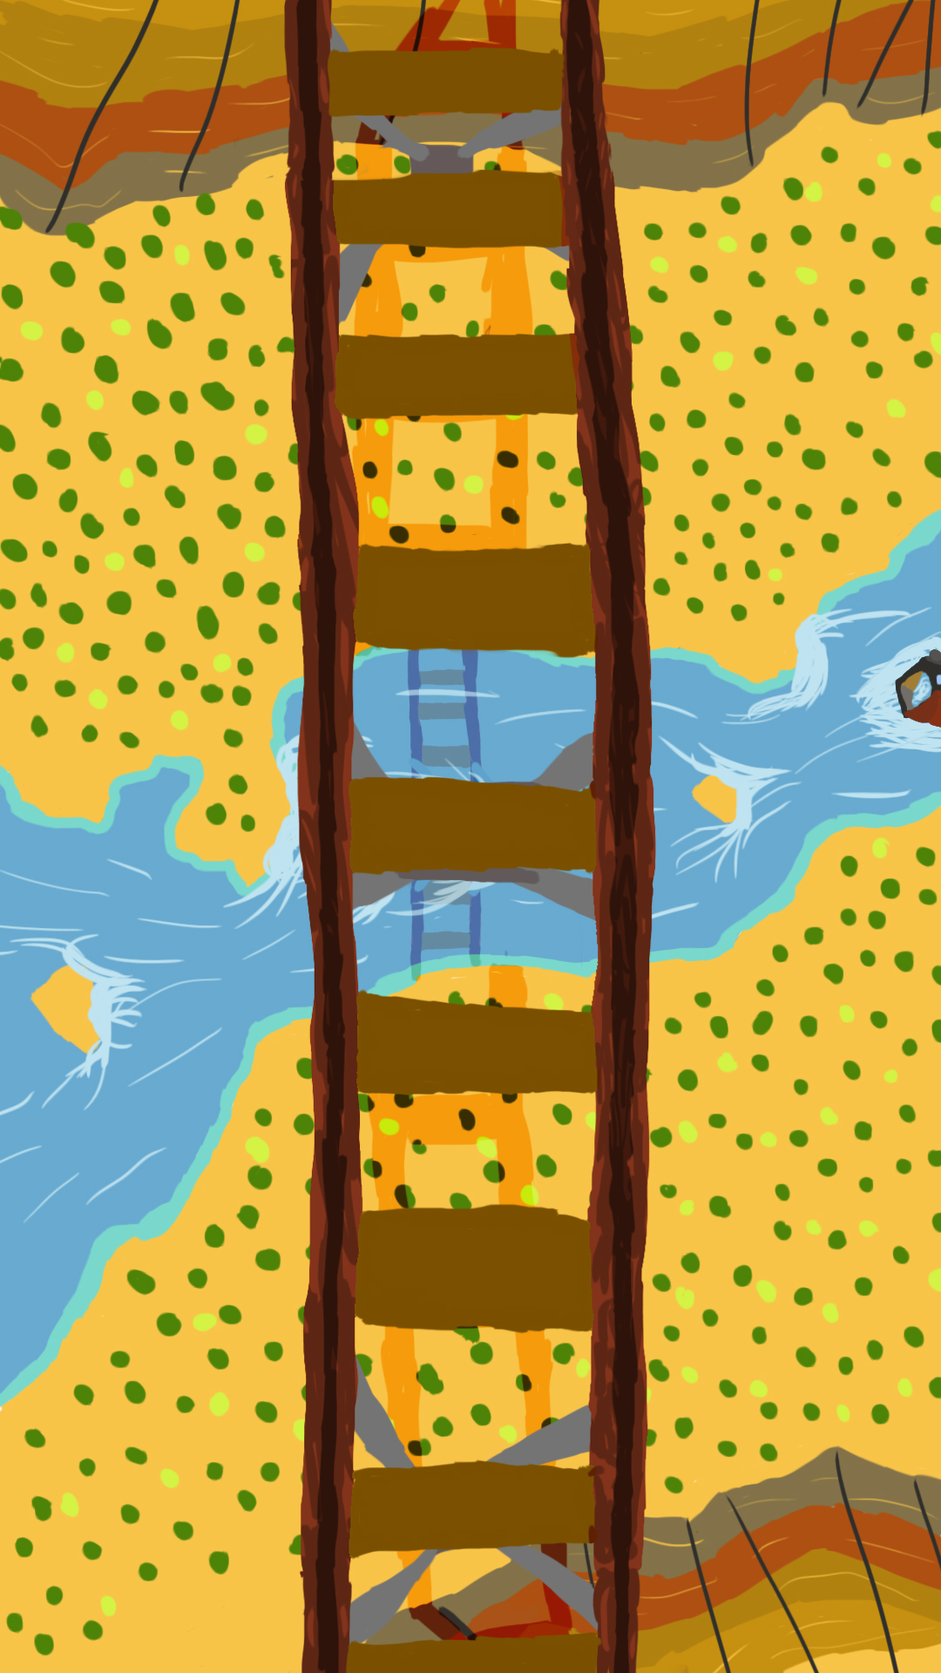
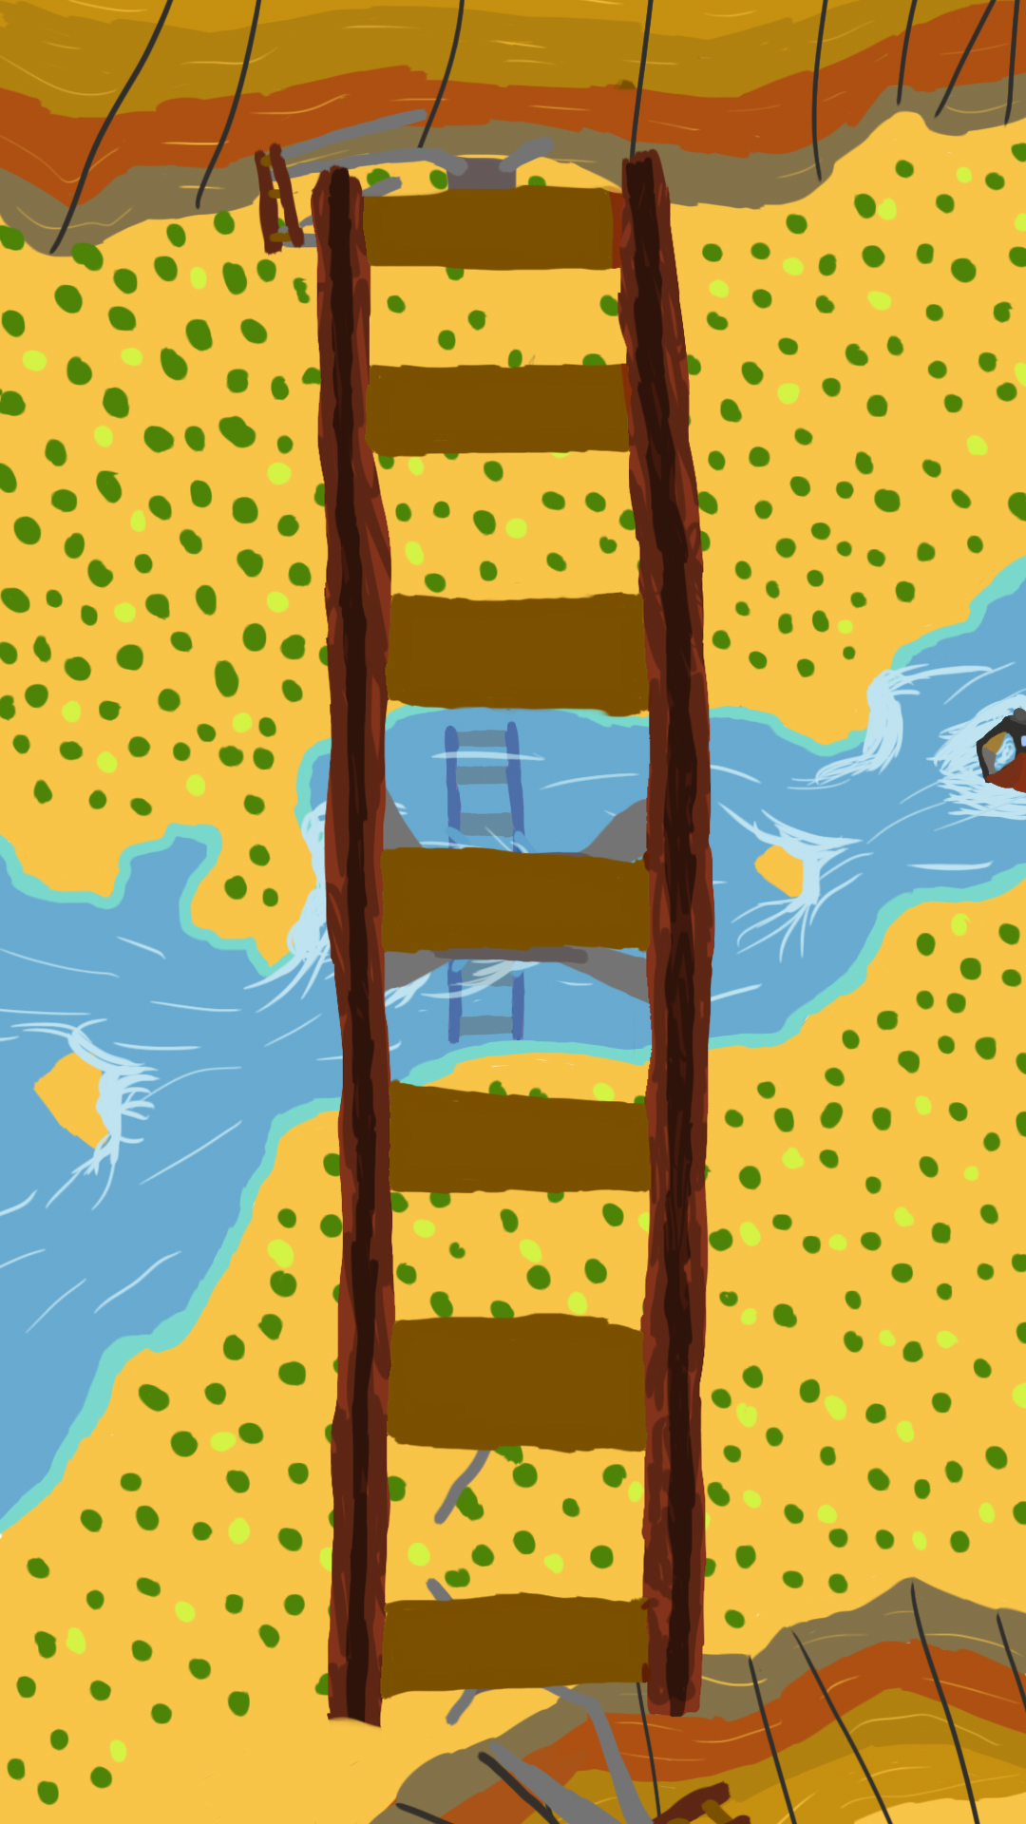
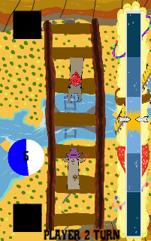
Art – Background Design
Iteration: less ‘busy’ background
Visible hazards in game scene
Notes:
Jack

Slide 11
Playtest Response
Speed values adjusted, players felt ___________
Players expressed ________ at recover power up occurring too frequently
Player ___ background/power bar
Players at chatacters?
Players said hitting opponent didn’t feel good – added screen shake
Players stealing their turn, felt cheated, limited input to half screen

Slide 12
Playtesting and the Iterative Cycle
“Playtesting is the most important part of the game development process” – Mike Ambinder, Senior Experimental Psychologist, Valve
Notes:
Fraser

Slide 13
Where’s the fun? – 4 Keys 2 Fun
People fun
Amusement from Competition and Cooperation
Hard fun
Challenge; Fiero from achieving a difficult goal
Notes:
Fraser

Slide 14
Design Lessons

Slide 15
Programming Lessons
Intuitive variable names
Clear code layout with comments

Slide 16
Management Lessons
Communication

Slide 17

Notes:
all

